Slide 1
FACIAL EXPRESSION RECOGNITION USING OPENCV
GROUP NO :- 80
GUIDE :- Prof. Suresh G. Shinde
GROUP MEMBERS :- Ronit Makhija
Puja Deshmukh
Divya Dhamane
Notes:
Good afternoon sir. So, our final year project is FER using opencv.

Slide 2
MOTIVATION
Significant debate has risen in past regarding the emotions portrayed in the world famous masterpiece of Mona Lisa. British Weekly „New Scientist‟ has stated that she is in fact a blend of many different emotions, 83%happy, 9% disgusted, 6% fearful, 2% angry.
We have also been motivated observing the benefits of physically handicapped people like deaf and dumb. But if any normal human being or an automated system can understand their needs by observing their facial expression then it becomes a lot easier for them to make the fellow human or automated system understand their needs.
Notes:
So, now why did we implement this project?
The reason is that in small countries like Nepal the crime rate is high and there are no automatic systems that an track a persons activity. As we know that the facial expression of an individual changes during different activities, we can easily analyze if the person is doing some criminal activity using fer.
Another application of fer is in the field of business. Many companies are already using fer to understand their customers mood after interacting with their products. In this way they can improve their product if it feels necessary.
So this is the motivation behind this project.

Slide 3
INTRODUCTION
With the advent of modern technology our desires went high and it binds no bounds. In the present era a huge research work is going on in the field of digital image and image processing. The way of progression has been exponential and it is ever increasing. Image Processing is a vast area of research in present day world and its applications are very widespread.
Image processing is the field of signal processing where both the input and output signals are images. One of the most important application of Image processing is Facial expression recognition. Our emotion is revealed by the expressions in our face.
Notes:
First of all, paul Ekman and Wallace v Friesen developed a system in 1980s called emotion facial action coding system (emfacs) from which FER is derived.
What is FER? FER is the task of identifying the emotion based on the facial expression of humans. Various emotions that can be recognized are-happiness,sadness,anger,fear,surprise.
Using fer we can analyze facial expression from both static images as well as videos to classify ones emotion

Slide 4
PROBLEM STATEMENT
The goal of this project is to use a machine learning model to take live image input from user using the webcam and based on the expression of the user predict which emotion is being conveyed by the user at that time. The emotions can be happy, sad, fear, excited, surprised, neutral or disguised.
Notes:
As discussed earlier, fer is used to analyze human emotions. So, our goal is to build a ml model that can take live images as input using webcam of computer and then analyze the facial expression and based on that analysis give the emotion of the person

Slide 5
LITERATURE SURVEY
Sr No | Title | Authors | Year | Conclusion
1. | Emotion Detection Using OpenCV for automatic facial recognition. | Jonathan Hicks | 2019 | In this paper, haar cascade classifier is used to detect a face and then compare it with the images in the database to classify the emotion. The underlying problem in this paper is that it cannot detect a partially blocked face.
2. | Facial Emotion Recognition using Convolutional Neural Networks | Akash Saravanan,Gurudutt Perichetla,Dr. K.S.Gayathri | 2019 | The final accuracy of 0.60 was achieved using the Adam optimizer with modified hyperparameters. It should also be noted that a nearly state-of-the-art accuracy was achieved with the use of a single dataset as opposed toa combination of many datasets.
Notes:
Main source used for face detection and feature extraction is cascade classifier.

Slide 6
LITERATURE SURVEY
Sr No | Title | Authors | Year | Conclusion
3. | Emotion Recognition and Drowsiness Detection using Digital Image Processing and Python | Pramoda, Arun P, Athul, Bharath, B Naveen Reddy | 2021 | In this paper they have used CNN algorithm for emotion classification and open cv for facial recognition. They faced challenges like ,Due to changes in pictures caused by lighting, ageing, and other variables, achieving accuracy in real time scenario is a major disadvantage.
4. | Face Detection And Recognition Using OpenCv | Suganthi.A, Poongothai.K, Prashanthini.K, Sangeetha.C | 2021 | In this paper they have compared three face recognizers: Eigen Faces, Fisher Faces, Local Binary Pattern Histogram(LBPH) and concluded that LBPH is most accurate.
5. | Emotion Recognition Using Convolutional Neural Network (CNN) | Nur Alia Syahirah Badrulhisham and Nur Nabilah Abu Mangshor | 2021 | An emotion recognition application was developed using CNN. MobileNet algorithm was used and an average accuracy of 92.50% was achieved.
Notes:
Main source used for face detection and feature extraction is cascade classifier.
EigenFaces
FisherFaces
Local Binary Pattern Histogram

Slide 7
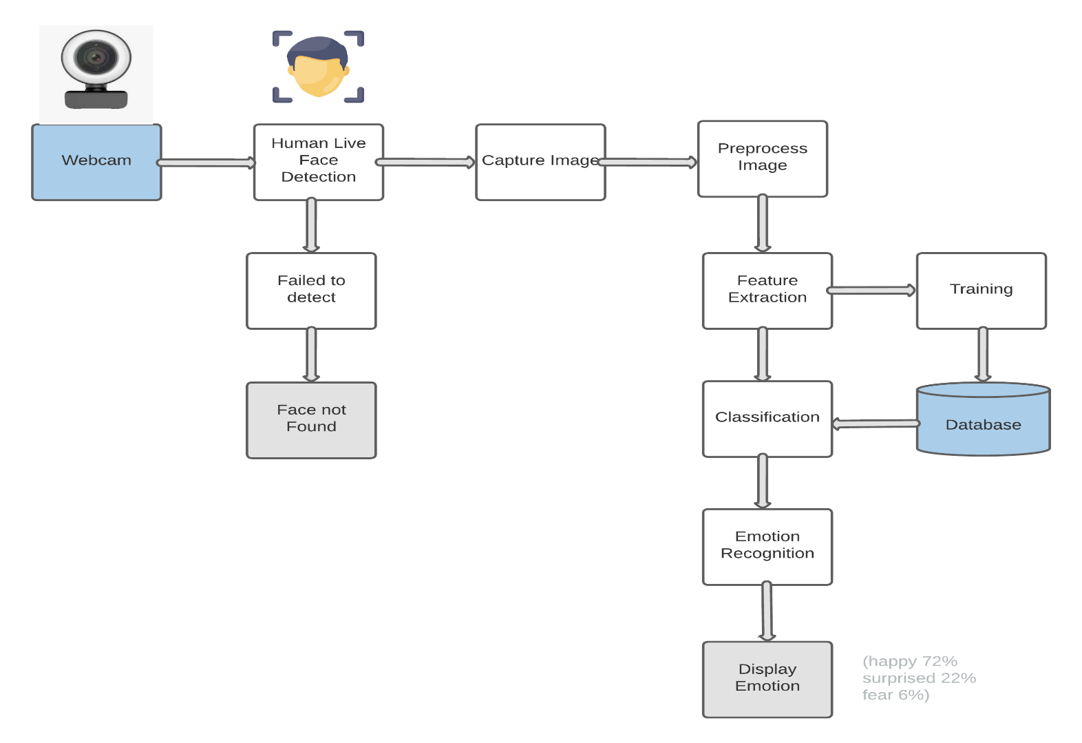
SYSTEM ARCHITECTURE

Slide 8
PRAPOSED ALGORITHM
Step 1 :Collection of a data set of images. (In this case we are using FER2013 database of 35887 pre-cropped, 48-by-48-pixel grayscale images of faces each labeled with one of the 7 emotion classes: anger, disgust, fear, happiness, sadness, surprise, and neutral.
Step 2 :Pre-processing of images.
Step 3 :Detection of a face from each image.
Step 4 :The cropped face is converted into grayscale images.
Step 5 : The pipeline ensures every image can be fed into the input layer as a (1, 48, 48) numpy array.

Slide 9
PRAPOSED ALGORITHM
Step 6 :The numpy array gets passed into the Convolution2D layer.
Step 7 :Convolution generates feature maps.
Step 8 :Pooling method called MaxPooling2D that uses (2, 2) windows across the feature map only keeping the maximum pixel value.
Step 9 :During training, Neural network Forward propagation and Backward propagation performed on the pixel values.
Step 10 :The Softmax function presents itself as a probability for each emotion class. The model is able to show the detail probability composition of the emotions in the face.

Slide 10
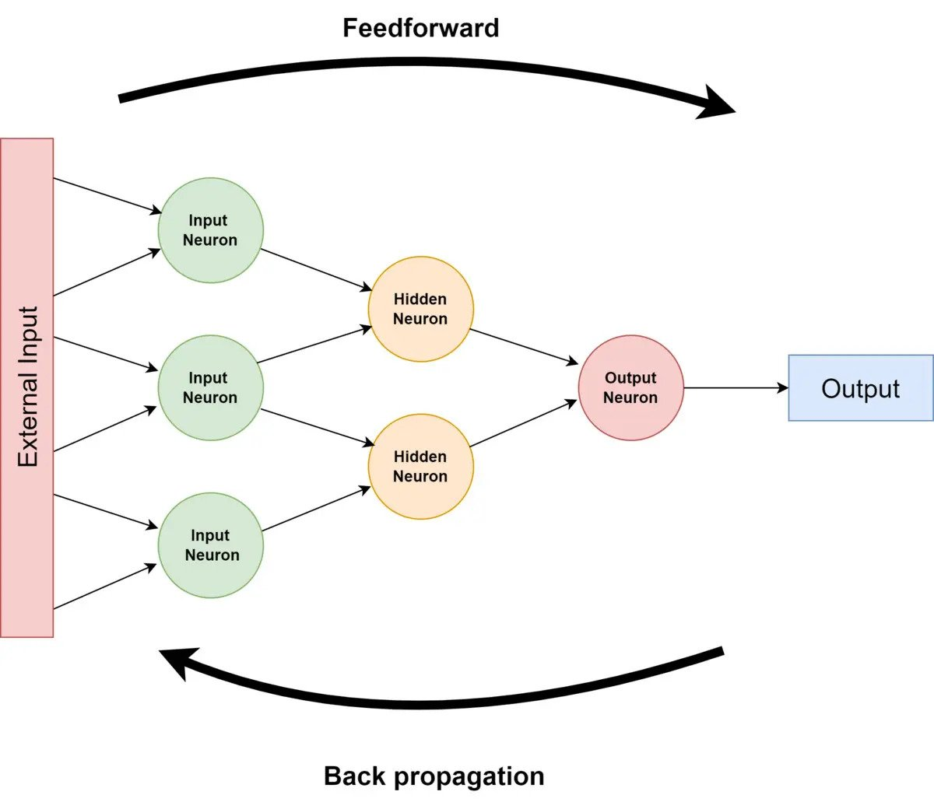
MATHEMATICAL MODEL
Neural Network Approach :
The neural network contained a hidden layer with neurons. The approach is based on the assumption that a neutral face image corresponding to each image is available to the system. Each neural network is trained independently with the use of on-line back propagation.

Slide 11
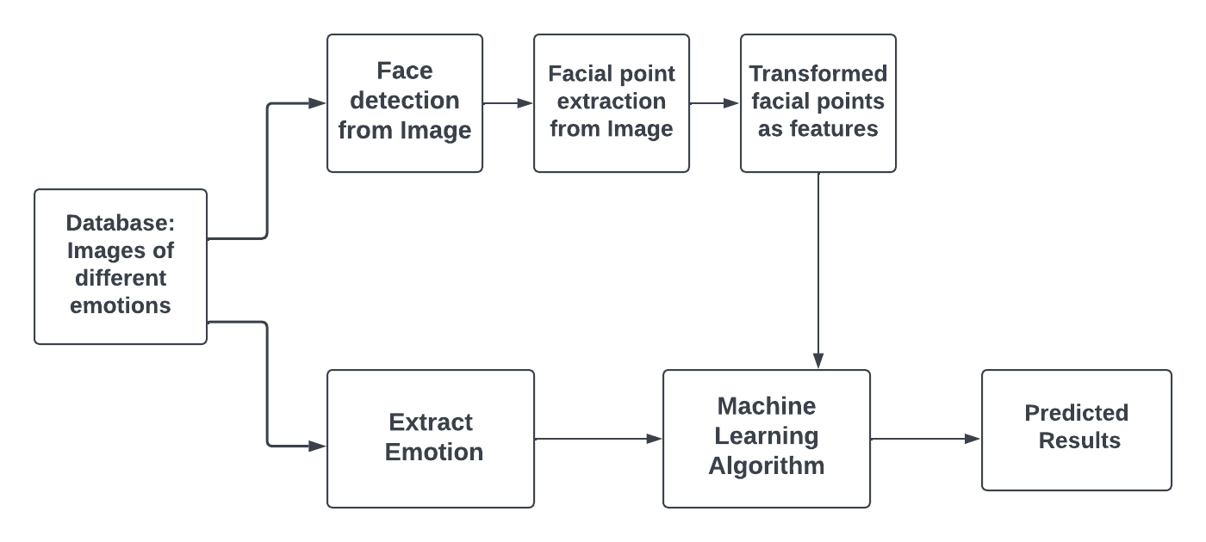
COMPONENT DIAGRAM

Slide 12
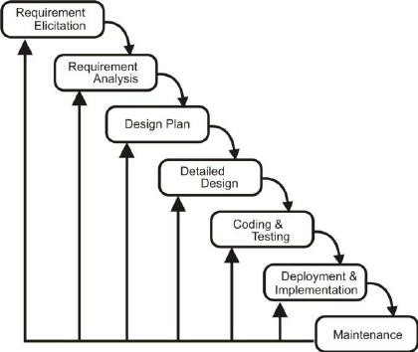
DEPLOYMENT DIAGRAM
Iterative waterfall model

Slide 13
SYSTEM REQUIREMENT
HARDWARE REQUIREMENTS
System : intel i3/i5 2.4 GHz.
Hard Disk : 500 GB
Ram : 4/8 GB
SOFTWARE REQUIREMENTS
Operating system : Windows XP/ Windows 7/8
Software Tool : Open CV Python
Coding Language : Python
Toolbox : Image processing toolbox.

Slide 14
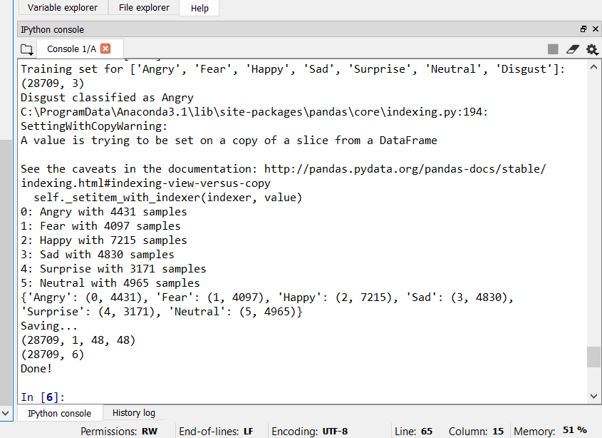
SCREENSHOTS OF MODULES
Dataset Trained Successfully

Slide 15
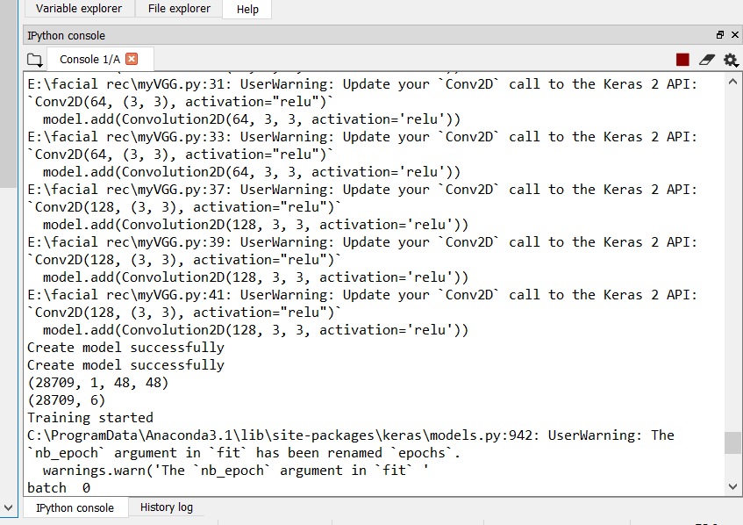
SCREENSHOTS OF MODULES
JSON Model created successfully.

Slide 16
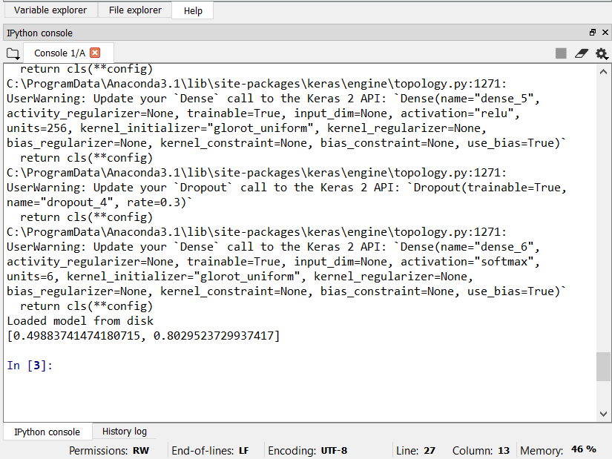
SCREENSHOTS OF MODULES
Accuracy check of the model

Slide 17
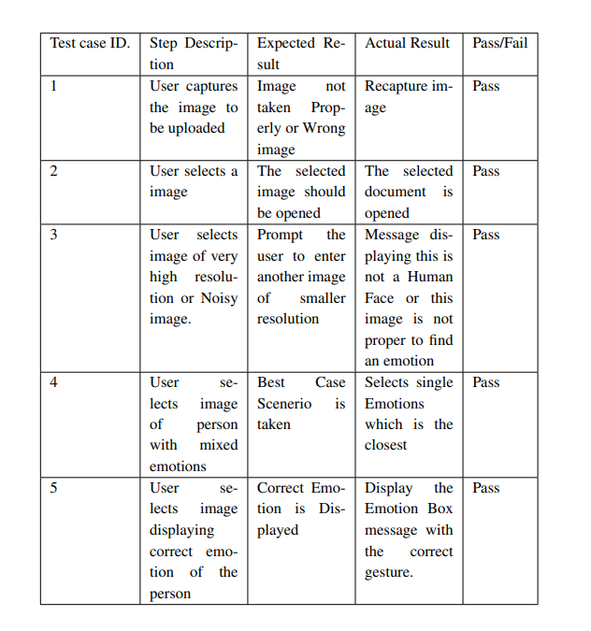
Screenshots of Test cases & Test results:

Slide 18
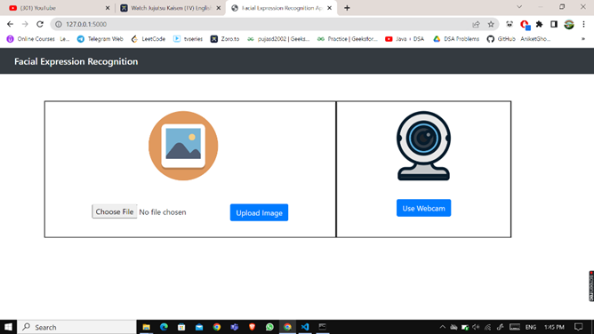
Screenshot of Output

Slide 19
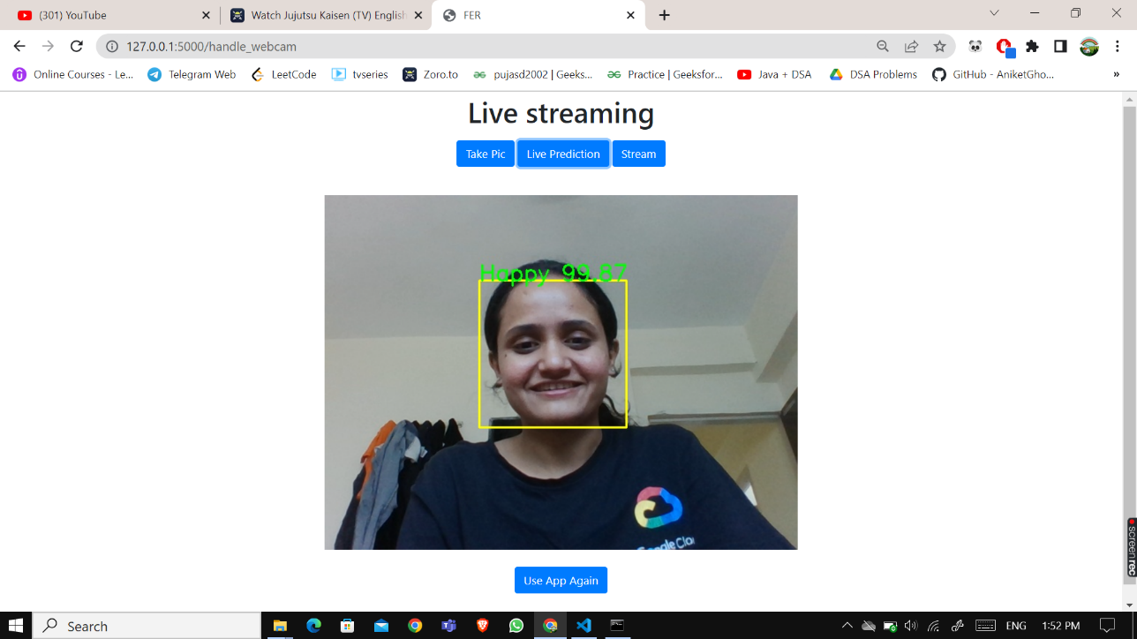
Screenshots of Outputs:

Slide 20

Screenshots of Outputs:

Slide 21
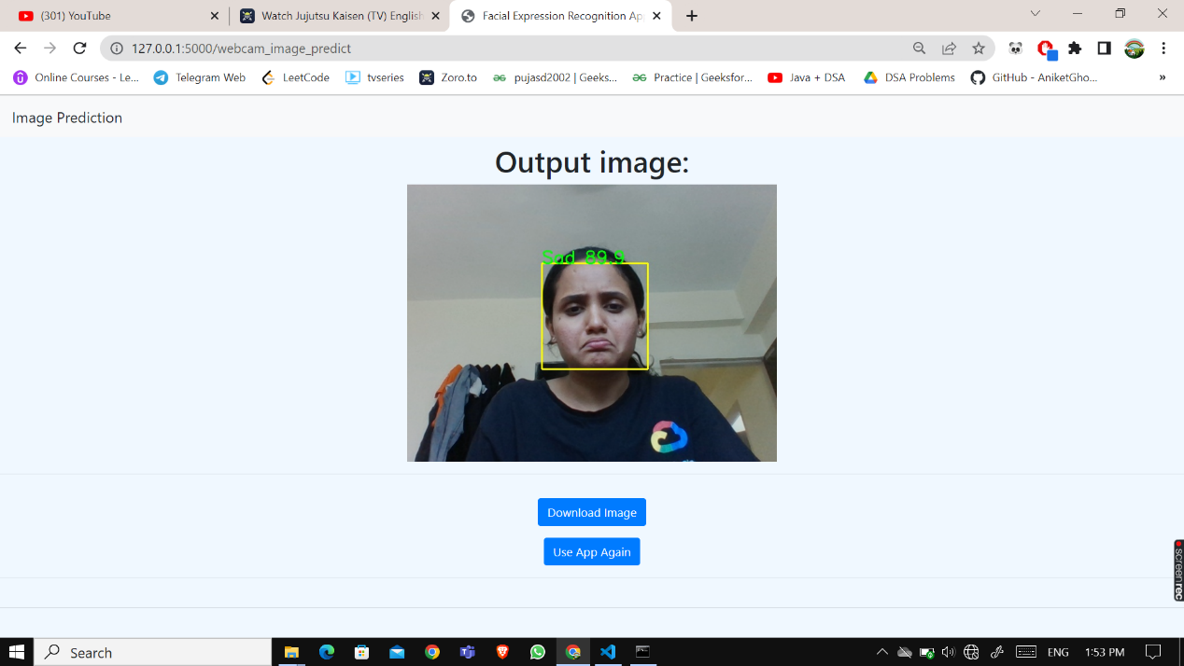
Screenshots of Output

Slide 22
SOCIAL IMPACT(APPLICATIONS)
Online Interviews
Video game testing.
Market research.
Fatigue – Driving Recognition
Criminal Interrogation
Notes:
These are the 5 out of many applications of FER.
FER is useful in online interviews to measure how candidate react to certain questions. This information can then be used to evaluate the result of the candidate.
Another application is in video game testing. FER can be used during video game testing phase. In this phase a group of users are asked to play the game for a given amount of time and their emotions and behavior are monitored. Using these insights developers can make changes in the final product as required.
FER can also be used for product research. It can be used to see how a customer is reacting or behaving after interacting with their product and changes in the product can be made accordingly.
One of the key applications of FER is that it can detect fatigue driving. It means that drowsiness while driving or rough driving can be recognized using fer.
Last application is during criminal interrogation. When a criminal is being interrogated his/her facial expressions can be examined while answering the questions and based on that we can conclude that whether the person is speaking the truth or lying.

Slide 23
ADVANTAGES
Early Detection of Person Behaviour.
Easy to Implement.
Cost Effective.
Easy to identify the conditions of the person.
Notes:
FER is very useful for event managers. Using fer they can learn whether the crowd is interested in a particular speaker or not
We know facebook is already is this application as while tagging a peron in a picture it automatically the user that can be identified in the picture.
CCTV cameras are secure but fer is more secure as using fer we can identify the moods of the attendes.

Slide 24
LIMITATIONS
Camera should be accurate.
Person face should capture properly.
Light conditions must be maintained.
Notes:
Image quality affects how well facial-recognition algorithms work. The image quality of scanning video is quite low compared with that of a digital camera.
2. Usually while training the model multiple angles are used for more accuracy, so while training if we use only a single angle, it cannot detect the emotion accurately.
3. Even though hd video are low in resolution, it takes a significant amount of storage and processing every frame of video is a very huge task. So usually only around 10-25% of frames are actually processed.

Slide 25
CONCLUSION
The facial expression recognition system presented in this work contributes a resilient face recognition model based on the mapping of behavioral characteristics with the physiological biometric characteristics. The physiological characteristics of the human face with relevance to various expressions such as happiness, sadness, fear, anger, surprise and disgust are associated with geometrical structures which restored as base matching template for the recognition system.
Notes:
So, to conclude this presentation, we implemented a machine learning model that can recognize facial emotions based on the dataset provided to it.
We used google colab for training the model and used a package called ImageDataGenerator from keras library for recognizing emotions. Currently the dataet that we are using is not quite enough for accuracy, so wee are aiming to find a dataset that is big enough to improve the accuracy of this model.

Slide 26
FUTURE WORK
In this project we got an accuracy of almost 80% which is not bad at all comparing all the previous models. But we need to improve in specific areas like-
number and configuration of convolutional layers
number and configuration of dense layers
dropout percentage in dense layers
But due to lack of highly configured system we could not go deeper into dense neural network as the system gets very slow and we will try to improve in these areas in future.
We would also like to train more databases into the system to make the model more and more accurate but again resources becomes a hindrance in the path and we also need to improve in several areas in future to resolve the errors and improve the accuracy.
Notes:
FER will be widely used in future. Few of the future applications of fer are
Researchers at Queen Mary Unoversity of London said that thye are working on using radio waves to access heart rate and breathing signals.
When a person starts watching a movie, radio sugnals are transmitted to them just like radar or wifi and that on analyzing the rebounded waves we get data for a persons heart rate and brrathing rates. Using this data we can recognize emotion even without face being visible.
According to a study, the current market for fer is worth 20millions usd and it will be increased to 56 millions usd in future till 2028
To increase road safety, Affectiva Automative AI is using safety cameras and microphones in vehicles to understand drivers emotions,tiredness level and attention. Using that data they upgrade the automobile if needed.

Slide 27
REFERENCES
Face Expression Recognition - What is it? How to use it? https://sightcorp.com/knowledge-base/facial-expression-recognition/
A Survey on Human Face Expression Recognition Techniques https://www.sciencedirect.com/science/article/pii/S1319157818303379
How Can You Benefit From Using Emotion Recognition Software? https://sightcorp.com/knowledge-base/emotion-recognition/#:~:text=Using%20facial%20emotion%20recognition%20can,review%20of%20the%20gaming%20experience.
Facial Emotion Recognition https://edps.europa.eu/system/files/2021-05/21-05-26_techdispatch-facial-emotion-recognition_ref_en.pdf

Slide 28
THANK YOU!

